Slide 1
Virtual Apartment Simulation
By: Murat Aksu, Arinze Nwolisa, Tattwamasi Tripathy & Heather Langdon
COSC 729 Virtual Reality and its Applications

Slide 2
Topics:
Goals and Objectives
Modeling
Exterior Modeling
Interior Modeling
VRML
Software
Problems Encountered and Future Goals

Slide 3
Goals and Objectives
Create a simulated environment which will showcase the following:
A mock-up that investors can use to perfect their vision
A model that the construction company can use to manipulate and prevent unnecessary pitfalls
A real view of the living environment for the potential tenant

Slide 4
Modeling
Modeling was done in 3D Studio Max.
The building and the park environment were downloaded from Turbosquid.com
Imported to 3DS max for further development.
Models for the kitchen, living room, and bedroom were also downloaded from Turbosqid.com
Biped models were inserted into the park environment to show human interaction

Slide 5
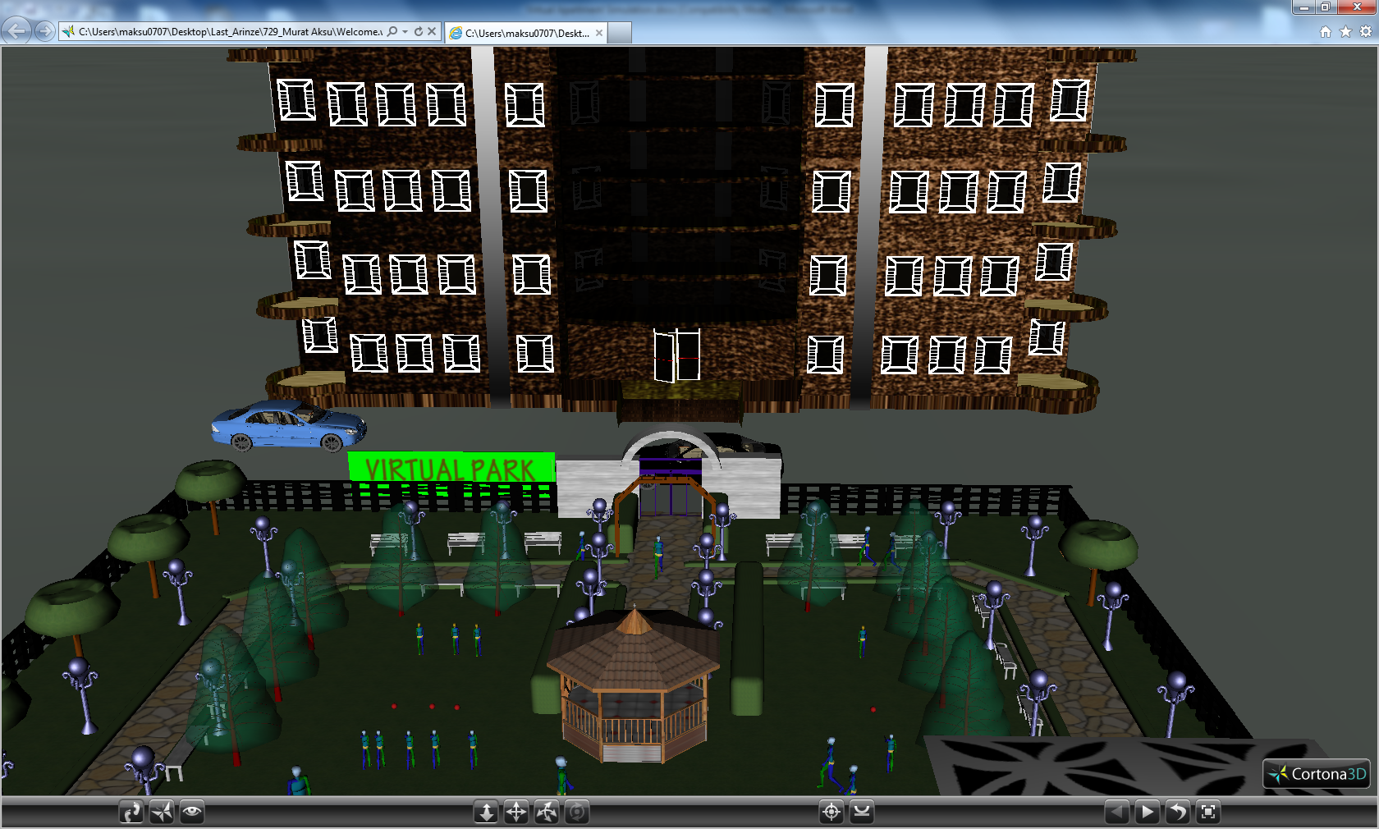
Exterior Modeling
Apartment Entrance

Slide 6
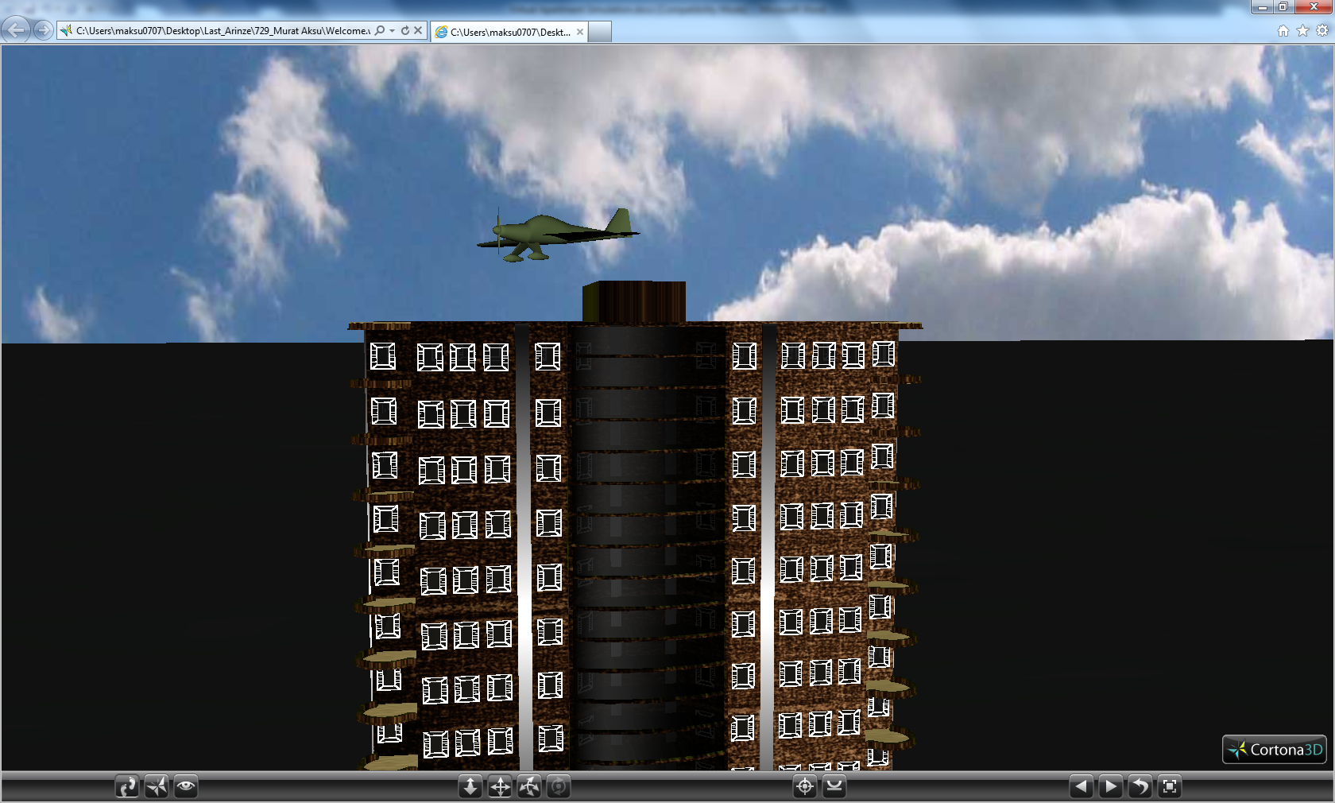
View of an airplane flying above the roof of the building

Slide 7
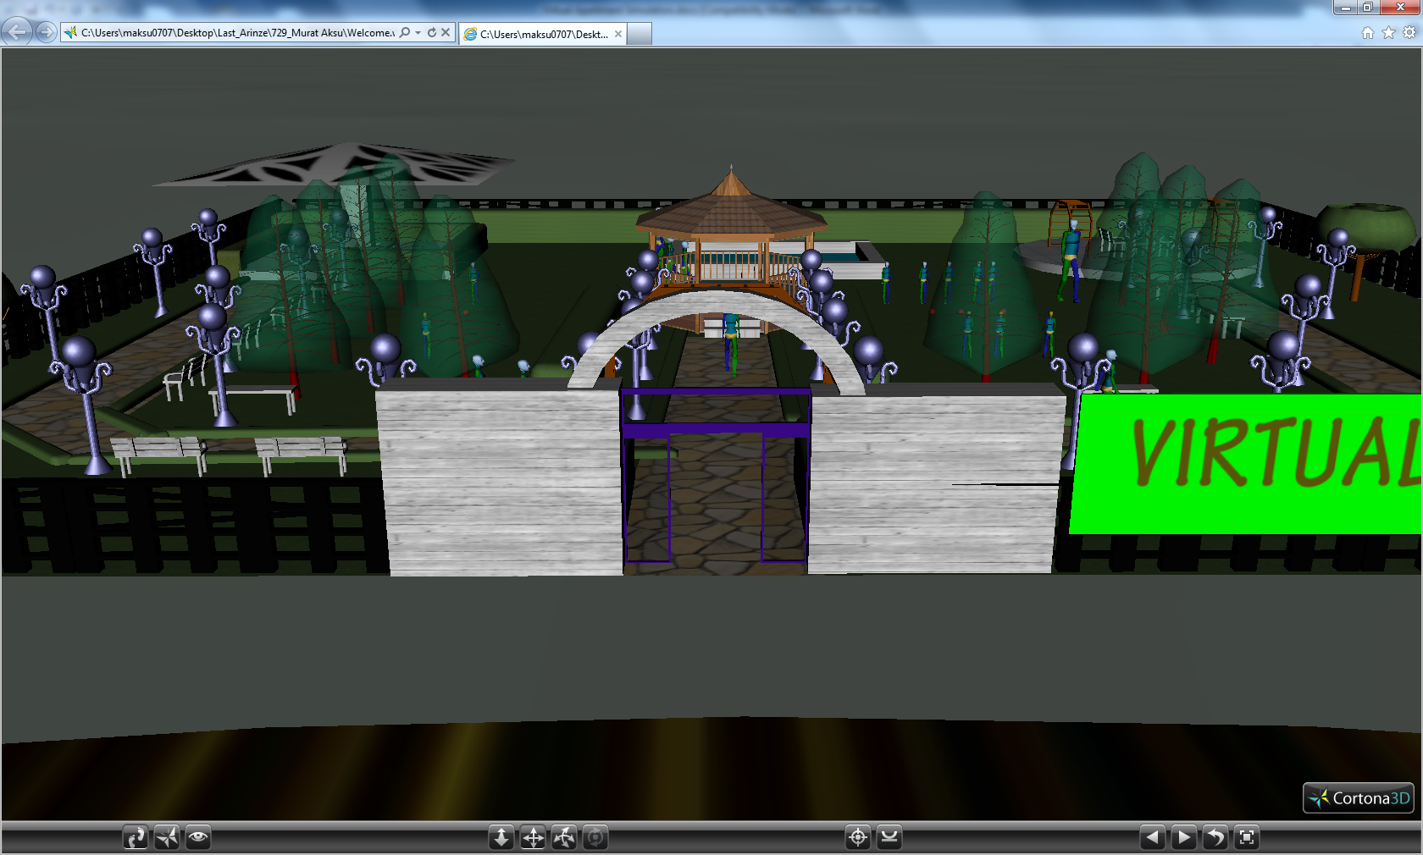
Entrance to the Park

Slide 8
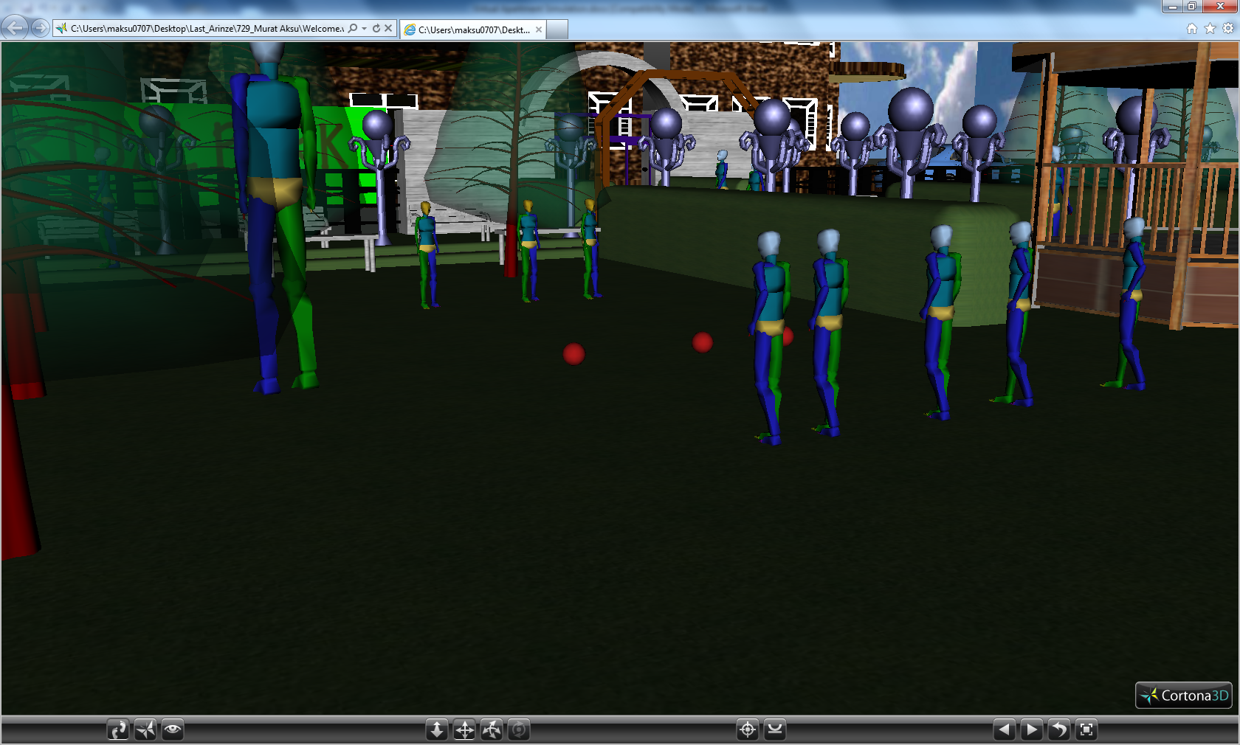
Children playing inside the park

Slide 9
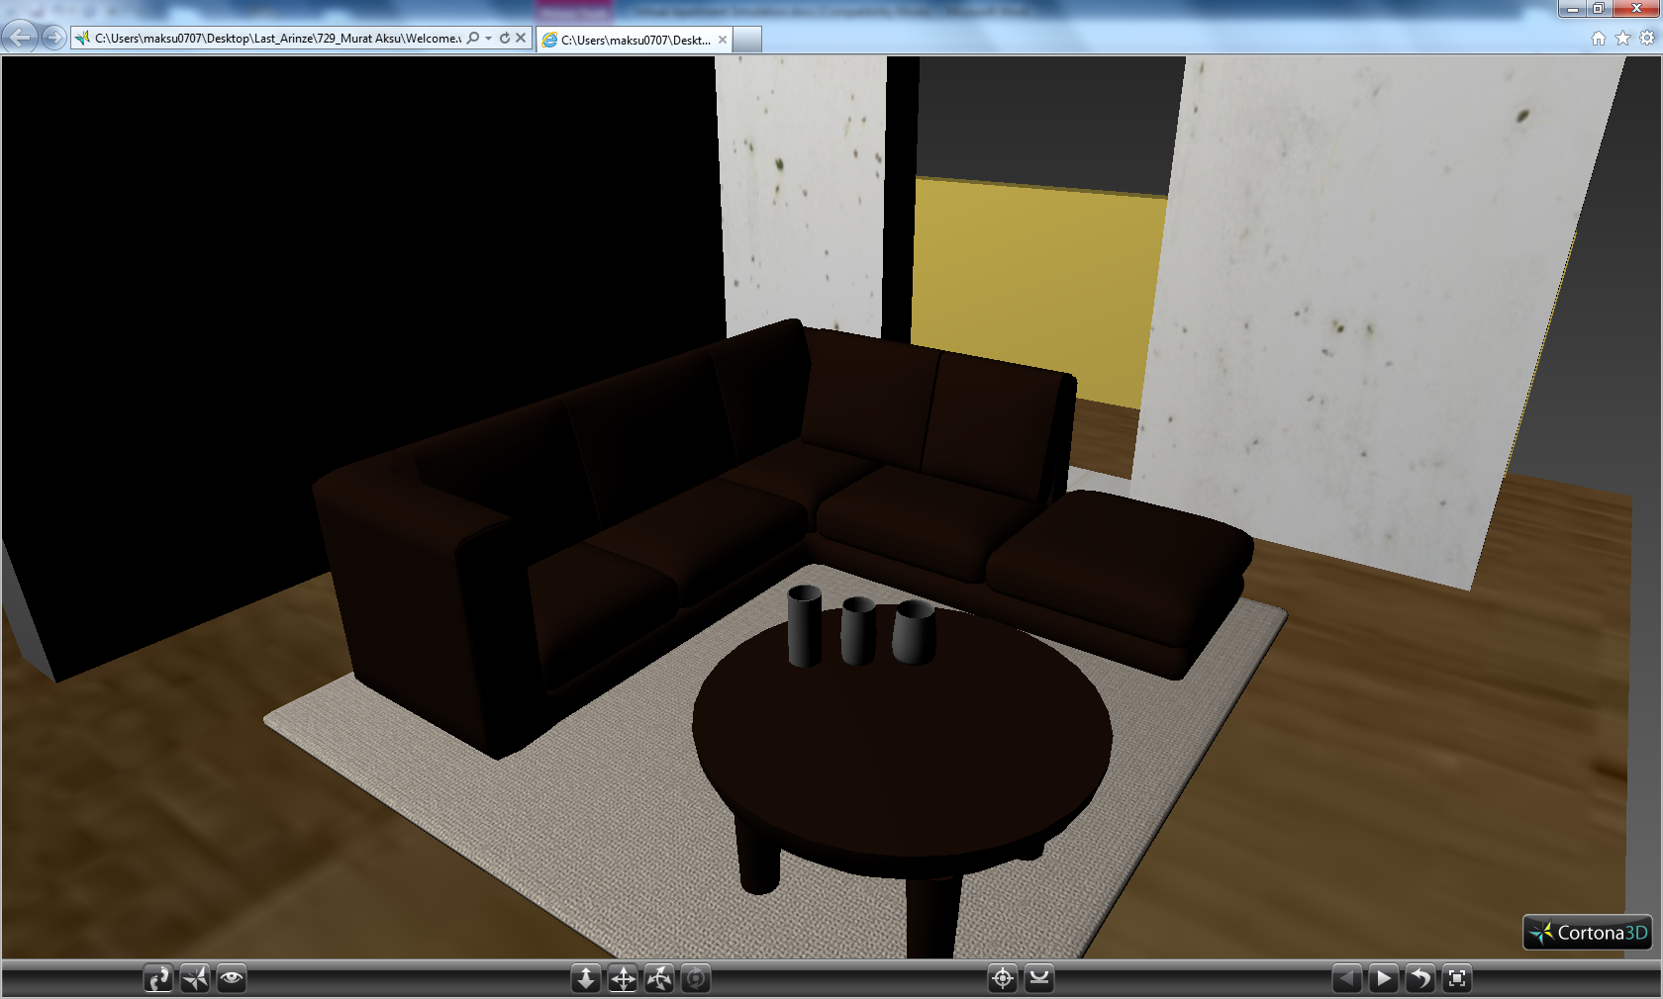
Interior Modeling
Living Room 1:

Slide 10
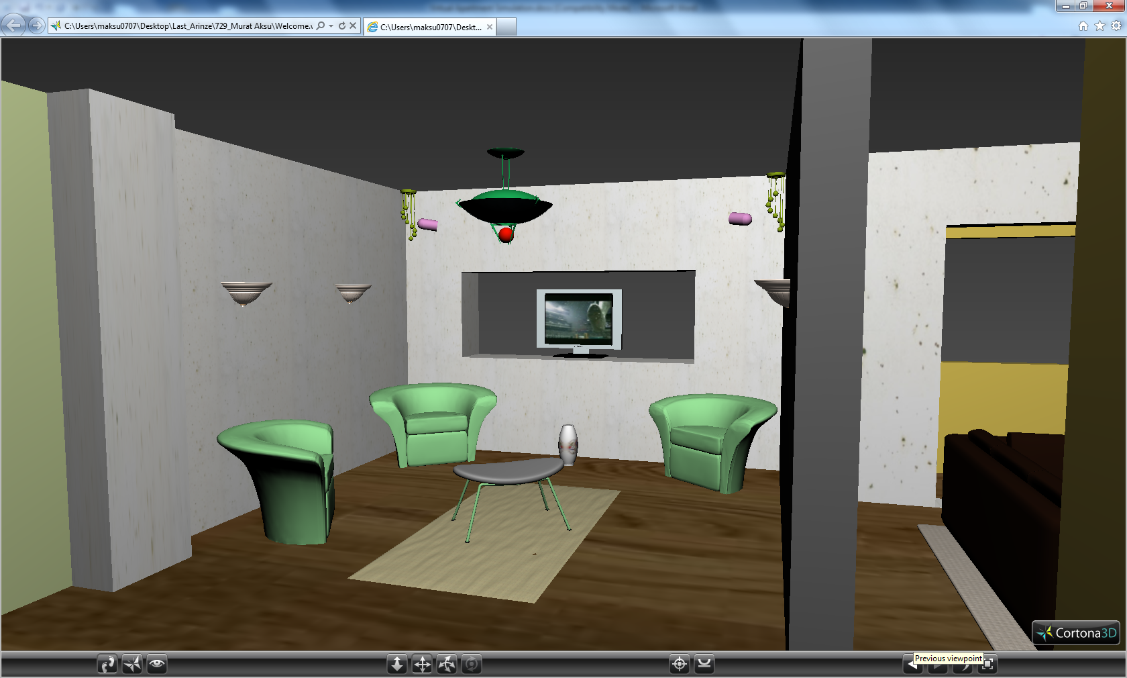

Slide 11
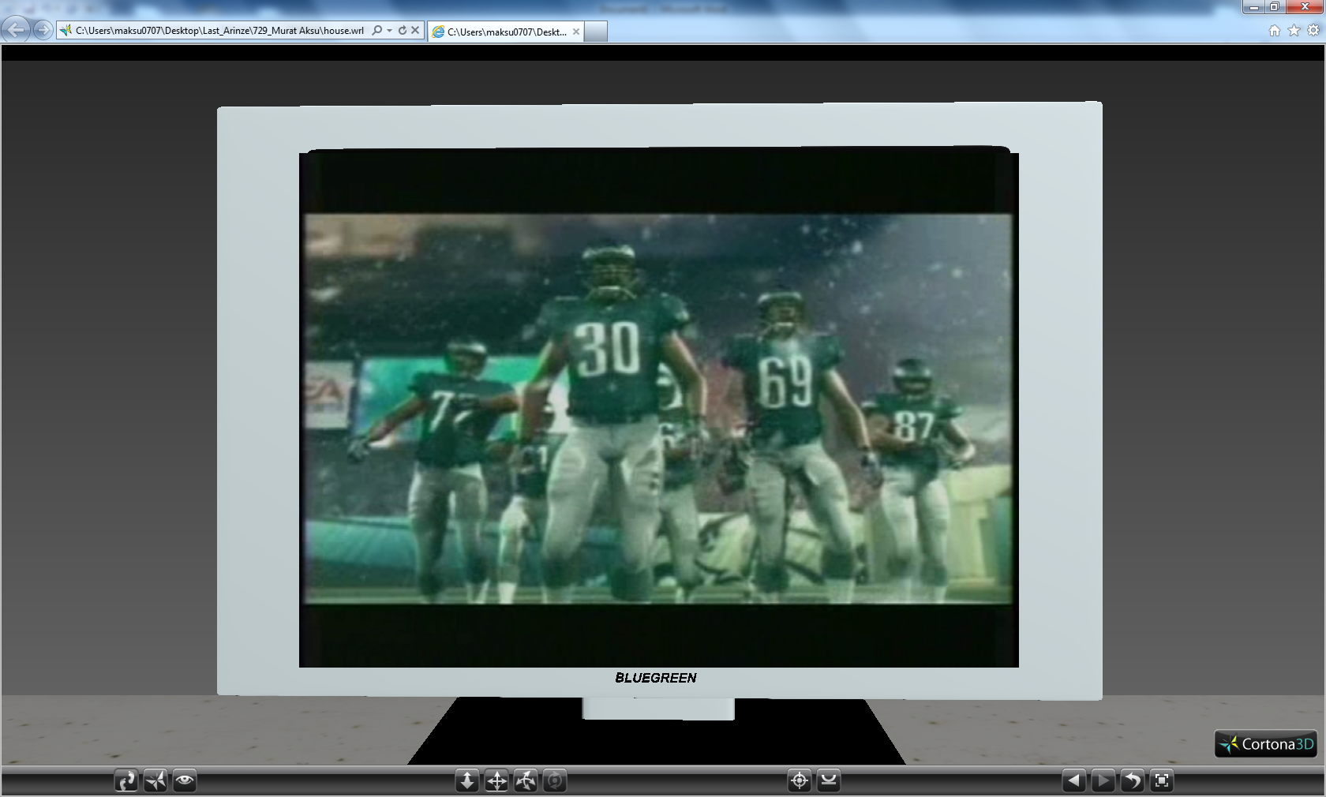
Living room TV:

Slide 12
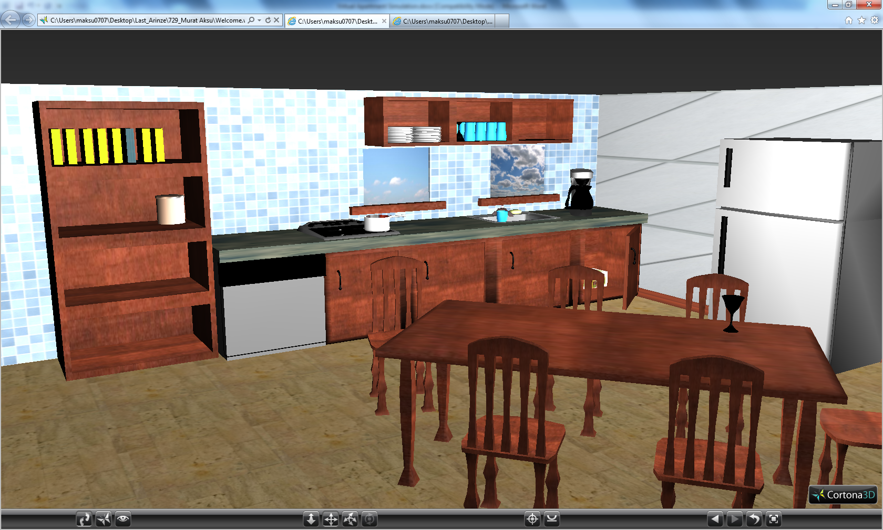
Kitchen:

Slide 13
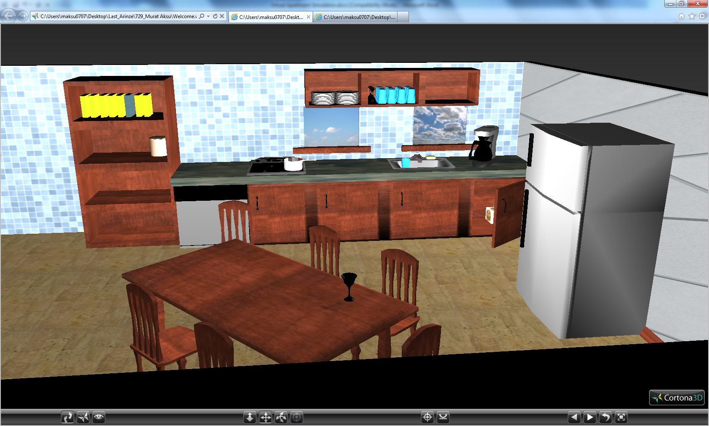

Slide 14
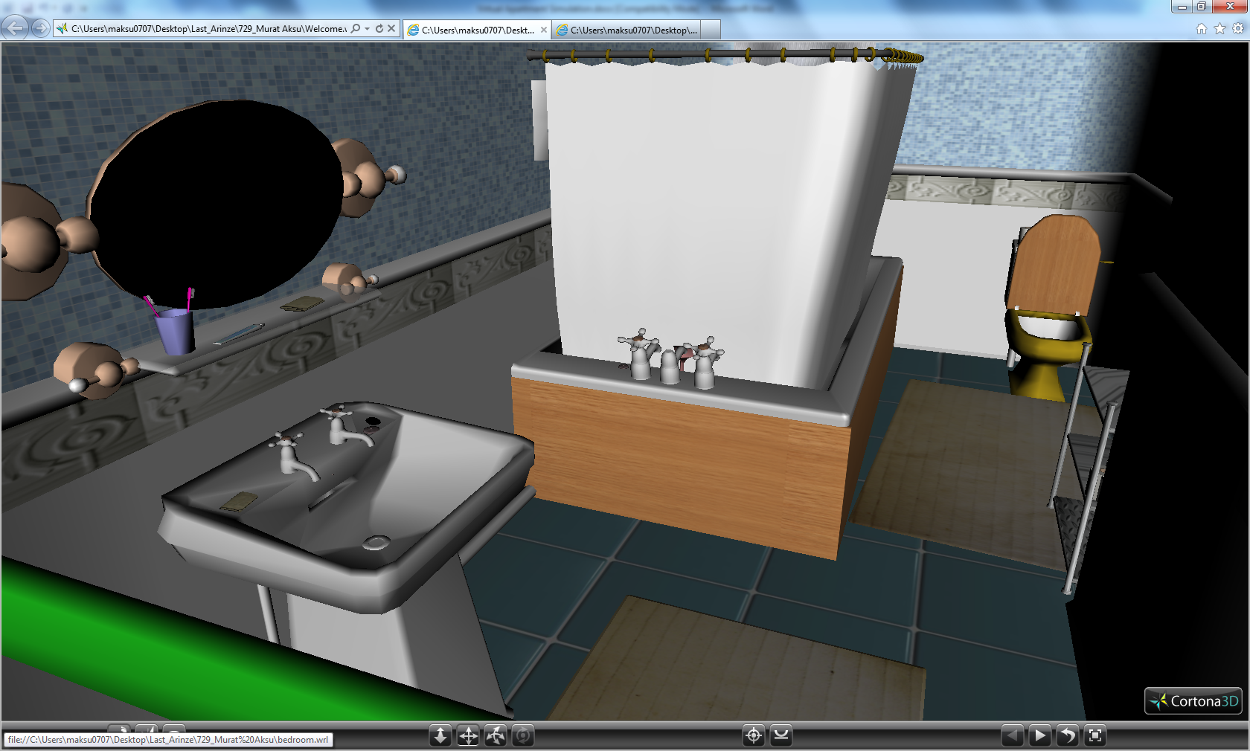
Bathroom:

Slide 15
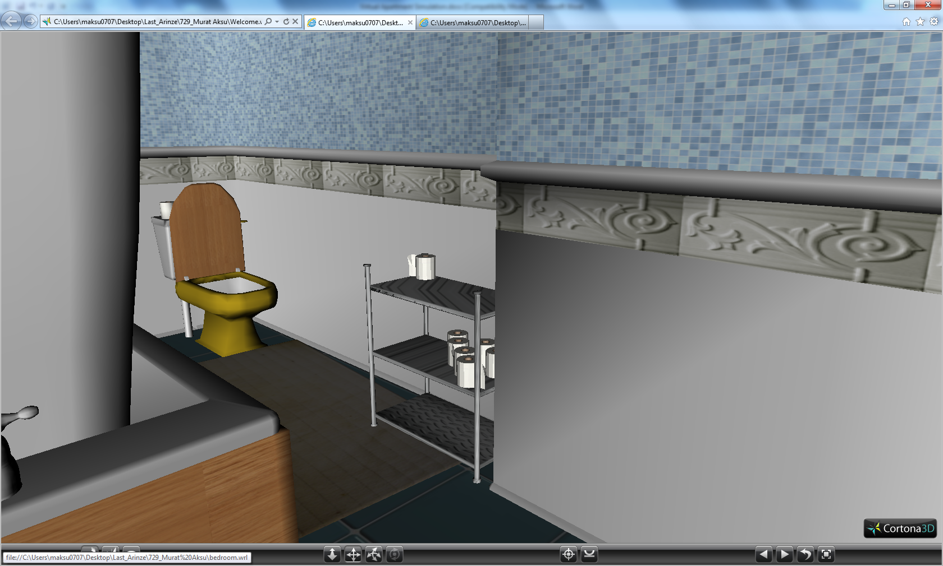

Slide 16
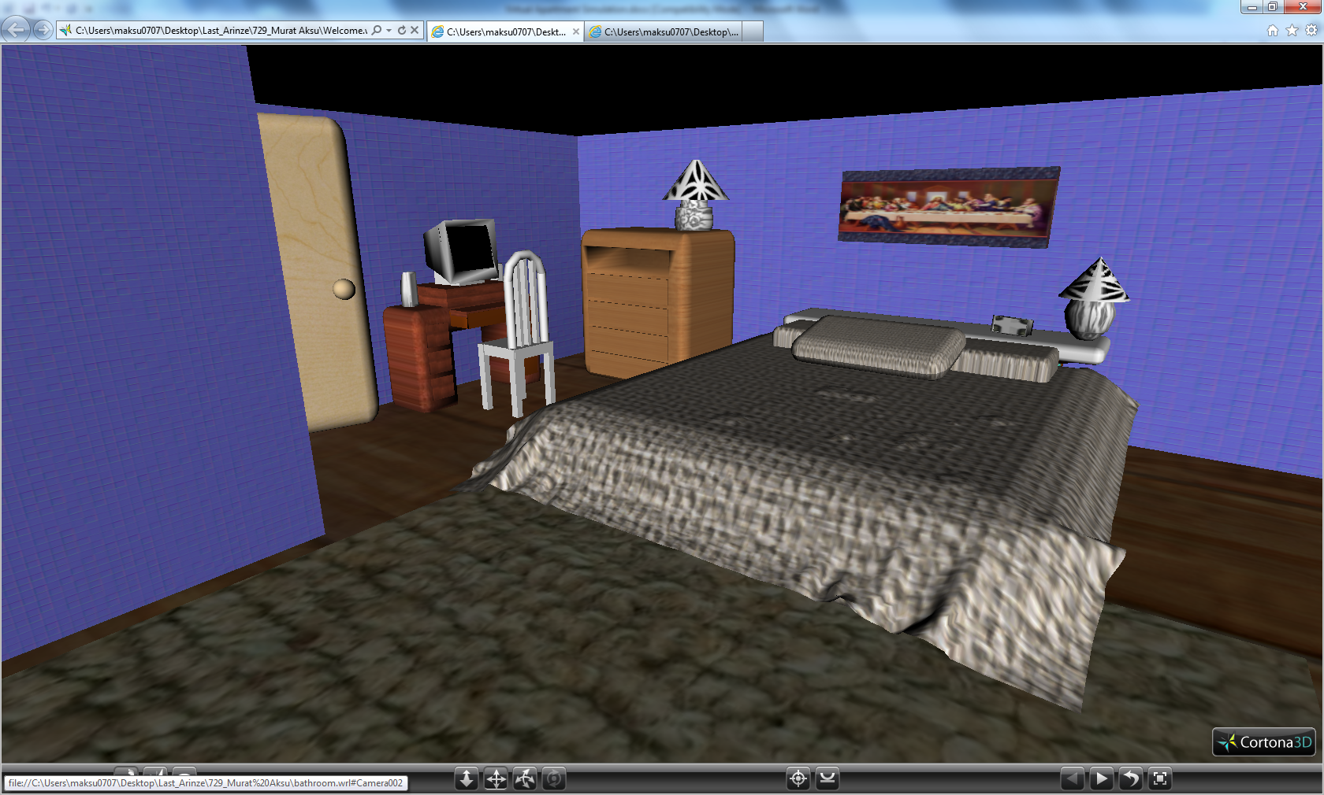
Bedroom:

Slide 17
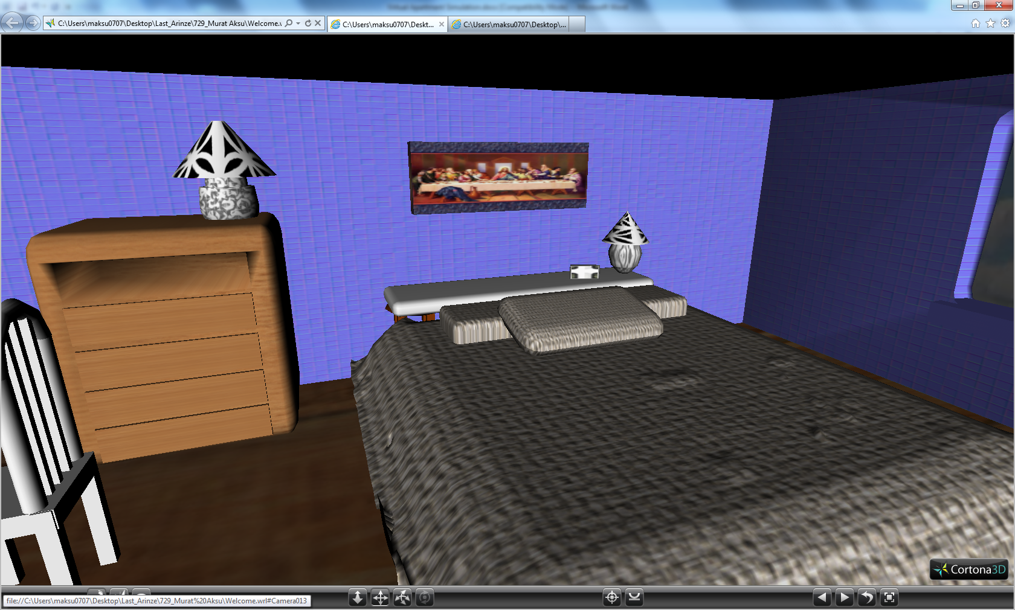

Slide 18
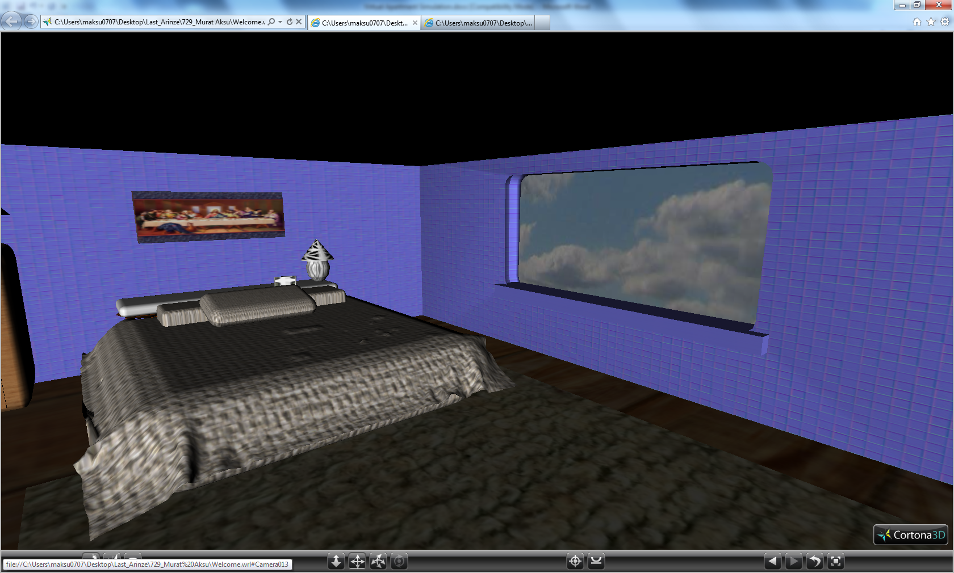

Slide 19
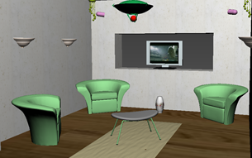
VRML:
VRML was used to add functionality to the virtual
environment through the incorporation of:
Touch Sensors
Lights
Interpolators
Anchor nodes

Slide 20
Lights
For the exterior of the building and park, we used the standard daylight system that is available in 3ds Max.
Inside the building we used multiple point lights to illuminate the interior of each room.

Slide 21
Sensors and Anchor Nodes:
Touch sensors were placed on the park gate, apartment building entrance, and the cars.
Anchor nodes were placed on the apartment entrance and the sliding gate of the park.
They are also added on each room’s wall to move forward to the next room in the tour, and on the floor to go back to the previous room.

Slide 22
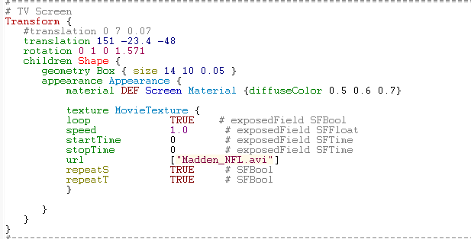
Living room video:
The .avi file has been added in VRML to provide the user a real time experience of watching television.

Slide 23

Interpolator
A color interpolator was applied to the hanging light of the living room.

Slide 24
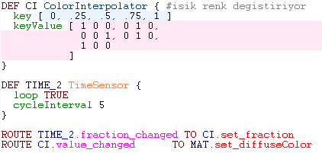
*Code to add color interpolator*

Slide 25
Software
Autodesk 3ds Max 2011 64-bit
Autodesk Maya 2011 64-bit
Cosmo player
Vrml Pad
Windows 7 Enterprise 64-Version
Cortona Player

Slide 26
Problems Encountered
There were few issues encountered during the designing phase. Such as:
Exporting from 3ds Max environment to VRML (.wrl).
Adding textures and background to the environment.
Adding bipeds to the park.

Slide 27
Future Goals
Implement more animation
Execute more human interaction for the different rooms
Open closets, more doors, storage areas, etc.
Camera views conducive to walking throughout the space freely
Notes:
In order for this application to be useful to people, we must also implement the actual dimensions and look of the projected space

Slide 28
Shortcomings…
There are two major things that could never be available with our current technology:
Feeling textures
Smelling scents

Slide 29
Demonstration…

